Slide 1

IS 253 OBJECT ORIENTED PROGRAMMING
LECTURE 5 & PRACTICALS

Slide 2
OBJECTIVES
Understanding Polymorphism.
Exploring Polymorphism case studies through examples.
Dynamic Binding.
Casting Objects.

Slide 3
INTRODUCTION
The term polymorphism literally means "having many forms“
A polymorphic reference is a variable that can refer to different types of objects at different points in time
The method invoked through a polymorphic reference can change from one invocation to the next.
All object references in Java are potentially polymorphic

Slide 4
INTRODUCTION
A class defines a type.
A type defined by a subclass is called a subtype, and a type defined by its superclass is called a supertype.
Example: You can say that Circle is a subtype of GeometricObject and GeometricObject is a supertype for Circle.
Polymorphism means that a variable of a supertype can refer to a subtype object.
The inheritance relationship enables a subclass to inherit features from its superclass with additional new features.

Slide 5
EXAMPLE: CLASS HIERARCHY
GeometricObject
Circle
Square
Triangle

Slide 6
POLYMORPHISM
Normally we have this when we create an object:
Circle circle = new Circle();
Polymorphism allows us to also do this:
GeometricObject circle = new Circle();
The object reference variable can be a super class of the actual object type! (Does NOT work the other way around: Circle is a GeometricObject but GeometricObject is not necessarily a Circle)

Slide 7
WHERE POLYMORPHISM IS HELPFUL ?
Definition of Arrays of Objects.
Passing parameters to methods.
Returning values from a method.

Slide 8
POLYMORPHIC ARRAY EXAMPLE
GeometricObject[] geometricObjects = new GeometricObject[5];
geometricObjects[0] = new Circle();
geometricObjects[1] = new Triangle();
geometricObjects[3] = new Square();
for (int i = 0; i < geometricObjects.length; i++) {
geometricObjects.describe();
}
You can put any subclass of GeometricObject in the GeometricObjects array!

Slide 9
POLYMORPHIC ARGUMENTS
public class Graphics {
public void draw(GeometricObject object) {
object.draw();
}
}
public class GraphicsTest {
Graphics graphics = new Graphics();
Triangle triangle = new Triangle();
Rectangle rectangle = new Rectangle();
graphics.draw(triangle);
graphics.draw(rectangle);
}

Slide 10
DYNAMIC BINDING
A method can be defined in a superclass and overridden in its subclass.
For example, the toString() method is defined in the Object class and overridden in GeometricObject.
Consider the following code:
Object o = new GeometricObject();
System.out.println(o.toString());
Which toString() method is invoked by o?
To answer this question, we first introduce two terms: declared type and actual type.
A variable must be declared a type.
The type that declares a variable is called the variable’s declared type.

Slide 11
DYNAMIC BINDING
Here o’s declared type is Object.
A variable of a reference type can hold a null value or a reference to an instance of the declared type.
The instance may be created using the constructor of the declared type or its subtype.
The actual type of the variable is the actual class for the object referenced by the variable.
Here o’s actual type is GeometricObject, because o references an object created using new GeometricObject().
Which toString() method is invoked by o is determined by o’s actual type.
This is known as dynamic binding.

Slide 12
DYNAMIC BINDING
A method can be defined in a superclass and overridden in its subclass.
Dynamic binding works as follows:
Suppose an object o is an instance of classes C1, C2, . . . , Cn-1, and Cn, where C1 is a subclass of C2, C2 is a subclass of C3, . . . , and Cn-1 is a subclass of Cn
That is, Cn is the most general class, and C1 is the most specific class.
If o invokes a method p, the JVM searches for the implementation of the method p in C1, C2, . . . , Cn-1, and Cn, in this order, until it is found.
Once an implementation is found, the search stops and the first-found implementation is invoked.

Slide 13
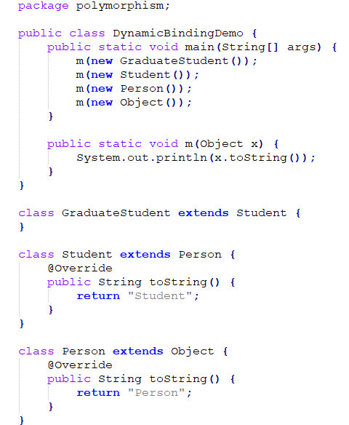
DYNAMIC BINDING:EXAMPLE

Slide 14
CASTING OBJECTS AND THE INSTANCEOF OPERATOR
One object reference can be typecast into another object reference. This is called casting object.
In the preceding example, the statement m(new Student()); assigns the object new Student() to a parameter of the Object type.
This statement is equivalent to:
Object o = new Student();// Implicit casting
m(o);
The statement Object o = new Student(), known as implicit casting, is legal because an instance of Student is an instance of Object.
Suppose you want to assign the object reference o to a variable of the Student type using the following statement: Student b = o;

Slide 15
CASTING OBJECTS AND THE INSTANCEOF OPERATOR
In this case a compile error would occur.
Why does the statement
Object o = new Student(); work but
Student b = o doesn’t?
The reason is that a Student object is always an instance of Object, but an Object is not necessarily an instance of Student.
Even though you can see that o is really a Student object, the compiler is not clever enough to know it.
To tell the compiler that o is a Student object, use explicit casting.

Slide 16
CASTING OBJECTS AND THE INSTANCEOF OPERATOR
The syntax for explicit casting is described below:
Enclose the target object type in parentheses and place it before the object to be cast, as follows: Student b = (Student)o; // Explicit casting
It is always possible to cast an instance of a subclass to a variable of a superclass (known as upcasting), because an instance of a subclass is always an instance of its superclass.
When casting an instance of a superclass to a variable of its subclass (known as downcasting).
For the casting to be successful, you must make sure that the object to be cast is an instance of the subclass.
If the superclass object is not an instance of the subclass, a runtime ClassCastException occurs.

Slide 17
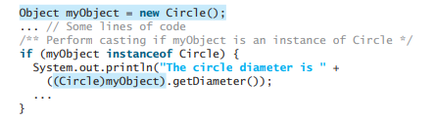
CASTING OBJECTS AND THE INSTANCEOF OPERATOR
For example, if an object is not an instance of Student, it cannot be cast into a variable of Student.
It is a good practice, therefore, to ensure that the object is an instance of another object before attempting a casting. This can be accomplished by using the instanceof operator.
Consider the following example :

Slide 18
CASTING OBJECTS AND THE INSTANCEOF OPERATOR
You may be wondering why casting is necessary.
The variable myObject is declared Object.
The declared type decides which method to match at compile time.
Using myObject.getDiameter() would cause a compile error, because the Object class does not have the getDiameter method.
The compiler cannot find a match for myObject.getDiameter().
Therefore, it is necessary to cast myObject into the Circle type to tell the compiler that myObject is also an instance of Circle.

Slide 19
CASTING OBJECTS AND THE INSTANCEOF OPERATOR
Why not define myObject as a Circle type in the first place?
To enable generic programming, it is a good practice to define a variable with a supertype, which can accept an object of any subtype.

Slide 20
END

